Slide 1
Understanding Models, , Views, and Controllers (C#)

Slide 2
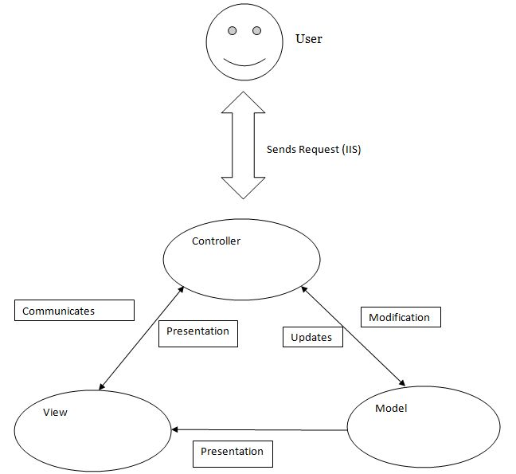
(M)odel (V)iew (C)ontroller

Slide 3

MVC in the real-world
Scenario: Imagine creating a To-Do list app where users can add tasks and organize them into lists.

Slide 4
Model – The Data
Tasks: Define what a 'task' is (e.g., name, due date, status).
Lists: Define a 'list' as a collection of tasks.

Slide 5
View – The Presentation
Tasks could have different font sizes or colors.
The View decides how the tasks and lists appear on the page.

Slide 6
Controller – Managing Actions
Users can add, edit, or complete tasks.
The Controller connects the 'Add Task' button to the Model, updating the data.

Slide 7
How MVC Works Together
The Controller passes user input to the Model.
The Model updates the data.
The View updates to reflect changes in the Model.

Slide 8
Why Use MVC?
Separation of concerns.
Easier to manage, scale, and maintain.
Reusable code components.

Slide 9
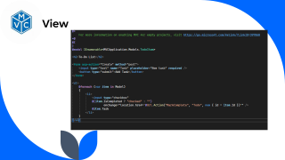
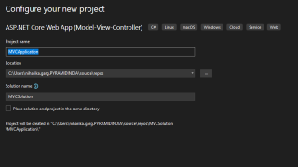
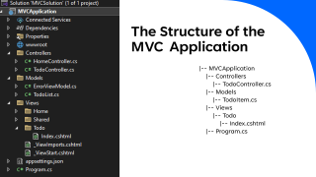
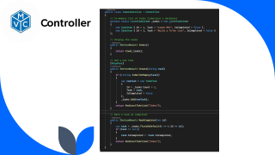
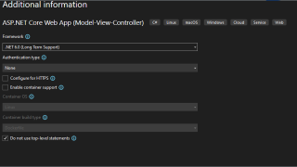
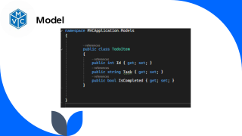
Example (Step to Step)

Slide 10


Slide 11
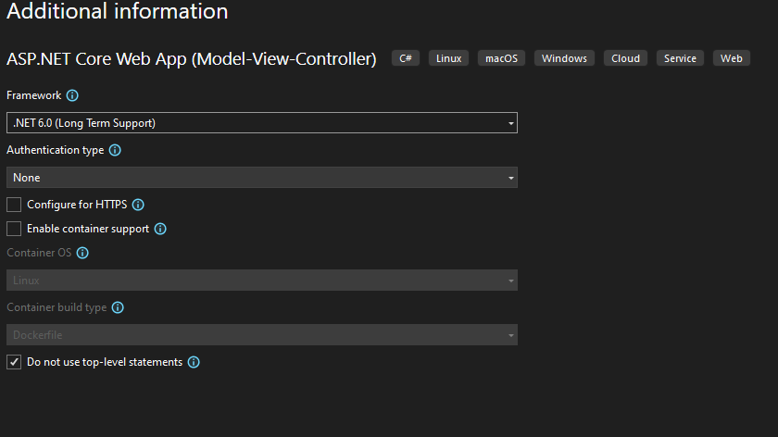

Slide 12
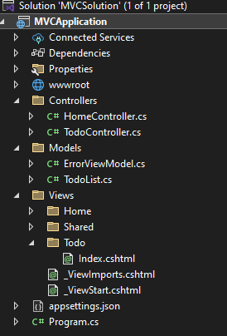
The Structure of the MVC Application
|-- MVCApplication
|-- Controllers
|-- TodoController.cs
|-- Models
|-- TodoItem.cs
|-- Views
|-- Todo
|-- Index.cshtml
|-- Program.cs

Slide 13
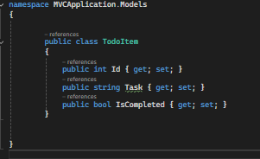
Model

Slide 14
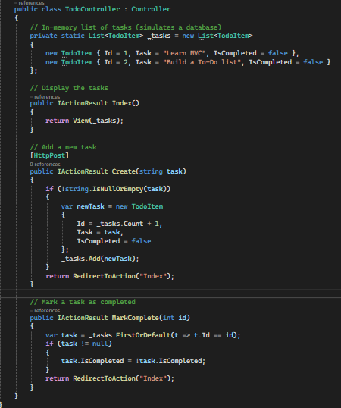
Controller

Slide 15
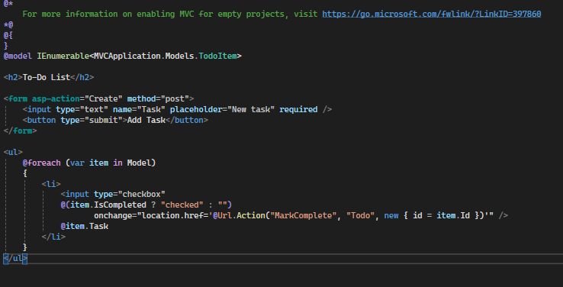
View

Slide 16
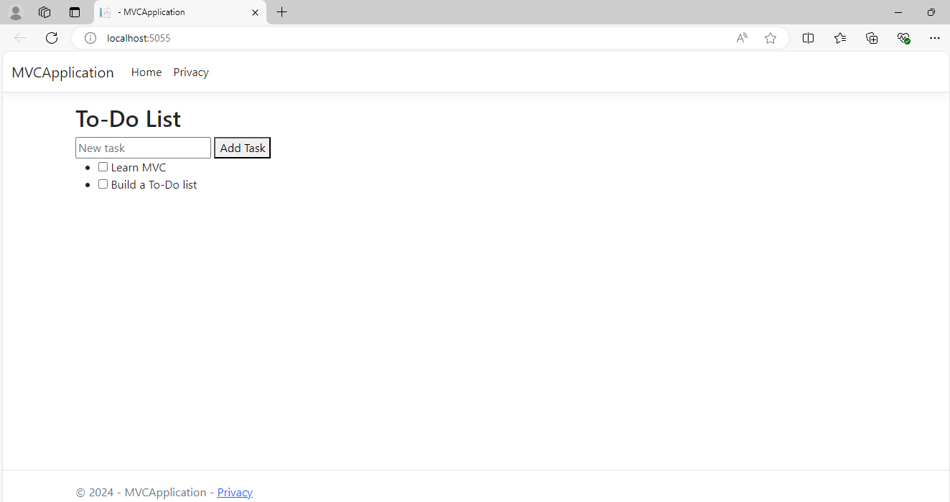

Slide 17
Conclusion
MVC is essential in structuring app.
Simplifies Management and Development.

Slide 18
Thank you

